Slide 1
PROBLEM statement : Module - X2
Water Provision Standard Table, measurements quantity of water to be supplied based on soil texture, water parameters to improve soil quality for excellent production.

Slide 2
OBJECTIVE
I. To be able to predict and give proper % of water required by the land. 2. To be able to control the pH and alkalinity of water. 3. To be able to give proper analysis of how much water is required and how much was the requirement by the soil.

Slide 3
Literature survey
Published Aug. 2018|Id: BAE-1537 By Sumon Datta, Saleh Taghvaeian, Jacob Stivers https://extension.okstate.edu/fact-sheets/understanding-soil-water-content-and-thresholds-for-irrigation-management.html Soil water thresholds are specific values of SWC(soil water content) indicating water availability for plant consumption. These thresholds are used to determine when and what % of water is required for irrigation according to the plant requirement .

Slide 4
Literature - 2
2.Published on 14 January,2028, 6:29:16 AM by name : Standard Methods for the Examination of Water and Wastewater https://beta static.fishersci.com/content/dam/fishersci/en_US/documents/programs/scientific/technical-documents/white-papers/apha-water-testing-standard-methods-introduction-white-paper.pdf The procedures described in these standards are intended for the examination of waters of a wide range of quality, including water suitable for domestic or industrial supplies, surface water, ground water, cooling or circulating water, boiler water, boiler feed water, treated and untreated municipal or industrial wastewater, and saline water. The unity of the fields of water supply, receiving water quality, and wastewater treatment and disposal is recognized by presenting methods of analysis for each constituent in a single section for all types of waters.

Slide 5
Water PROVISION Standard table :
It is well documented that water is an essential component for the survival of all living beings and development processes on earth. Water is used for domestic purposes, industrial processes and agriculture. 1.Plants cannot survive if the soil is too alkaline or acidic. 2.Different plants have there different requirements. 3.Plants like Indigo and Jute absorbs a lot of nutrients which later causes the land to turn barren. So proper water provision is required .

Slide 6
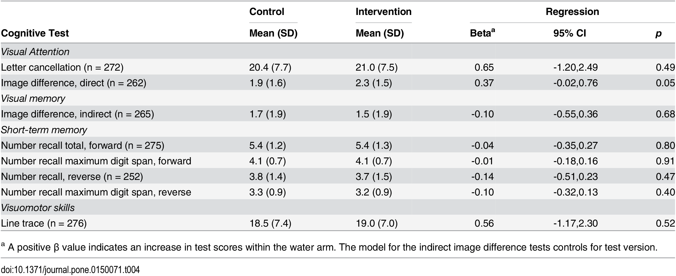
Some basic water arm tests done previously:
Reference : https://journals.plos.org/plosone/article

Slide 7
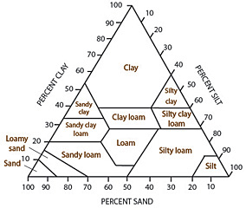
Types of Soil Texture and soil texture triangle:
Reference : https://www.qld.gov.au/environment/land/management/soil/soil-properties/texture

Slide 8
Soil texture and Properties
1.Soil texture is one of the most commonly used feature by the scientists and farmer to describe soils.
2.Texture refers to the construction, weight, or the size of the soil is present can be sand, silt, loam and clay.
3.It can be differentiated using Particle structure, size of the particles, water holding csapsacity etc.

Slide 9
Types of soil and water storage Capacity:
According to the surveys conducted within the year span before 2018 it is seen that :
Texture | Length of ribbon(mm) | Soil properties and Management implications | Crop growth support
Sandy | <15 | Little resistance to root growth, High infiltration rate, Low plant available water | None
Sandy Loam | 15-25 | Root growth not restricted, but highly susceptible to mechanical compaction, Moderate infiltration rate, Moderate plant available water. | ( Bajra, Maize, Ragi)
Loam | 25 | Root growth not restricted, Moderate infiltration rate, Moderate plant available water. | (Tomato, common vegetables)
Silty Loam | 25 | Root growth not restricted, Low to Moderate infiltration rate, Moderate plant available water. | ( Cereals , Fruits)
Clay Loam | 40-50 | Root growth not restricted, Moderately susceptible to mechanical compaction, Moderate to high plant available water. | (Lettuce, Chard, Snap Beans)
Clay | 50-75 | Root growth frequently restricted, Moderately to high susceptible to mechanical compaction, Moderate to high plant available water. Can lead to periodic water logging. | (Broccoli, Cauliflower, Potato, pea, Radish)
Heavy Clay | >75 | Root growth highly restricted, High susceptibility to mechanical compaction, causes severe water logging. | None

Slide 10
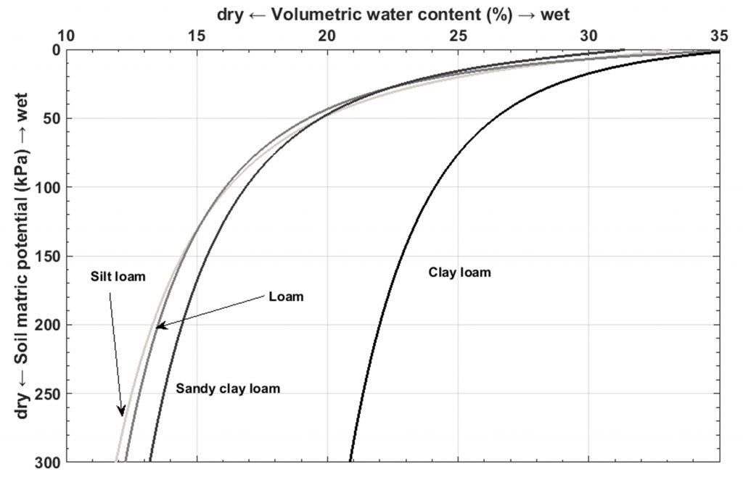
Soil water content and threshold for irrigation:
Reference : https://ieeexplore.ieee.org/document/7577635

Slide 11
References
https://law.resource.org/pub/in/bis/S03/is.1172.1993.html
Managing Soil Health: Concepts and Practices (psu.edu)
https://www.fao.org/3/t0234e/t0234e00.htm
https://extension.okstate.edu/fact-sheets/understanding-soil-water-content-and-thresholds-for-irrigation-management.html

